Slide 1
MAIN GOALS OF OUR ANALYSIS
Understanding the inner workings of a schizophrenic mind analyzing:
Brain connectivity with respect to our Region Of Interest (ROI)
Mean differences in reaction times and outcomes
Explore effect of experiment design on results :
Switch/no switch
A longer exposure to the cue(CSI)
Congruency between tests

Slide 2
TECHNIQUES WE WILL USE
PCA: reducing dimensionality of zmaps
CLUSTERING: to identify different shades in spectrum of schiz. (on zmaps)
THREE- WAY ANOVA (response times vs schiz/healthy, congruency/incongruency,…): to identify the differences between groups
To obtain explanation for reaction times
boxplots of healthy vs schizo
Not yet seen in class:
MIXED EFFECT MODELS

Slide 3








INITIAL AND FORSEEN PROBLEMS
A
B C
Non-normality
Dimensionality
Interpretation of health data

Slide 4
a voce

Slide 5
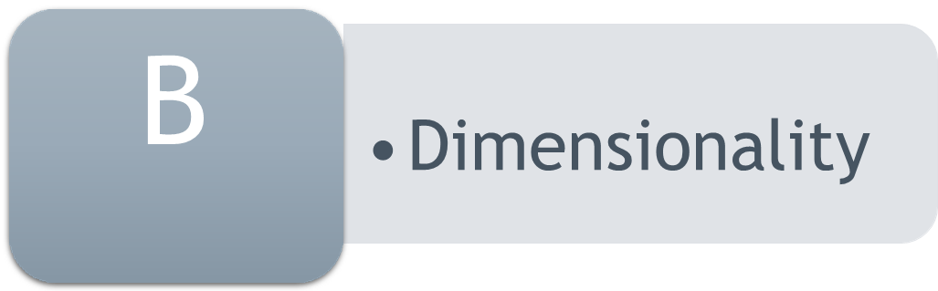
SOLUTIONS:
Reduction to a 83-features dataset
and PCA on this data
Possible incompatibility of PCA with clustering etc…

Slide 6
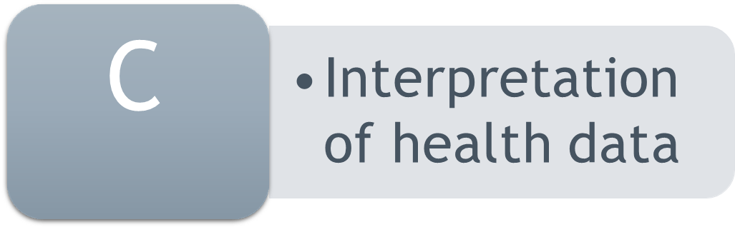
excessive demographic information (race, education, general information)
Sometimes incoherent/missing data on health/demographics: eg smoking habits
excessively specific data on health covariates
Detailed personal results on Barratt tests: impulsiveness measure

Slide 7
Next steps (we haven't explored yet)
More on …
How to define distance between individuals on zmaps (necessary for clustering)
Spatial Analysis

